Slide 1

Rain Gauge sensor package
ARTS Lab Weekly Update
Ryan Brown

Slide 2
Working Circuit
The circuit is working on the Arduino starter kit board
Working on creating a PCB board on KiCad
Working on creating a smaller circuit on perf board so prototyping can begin

Slide 3
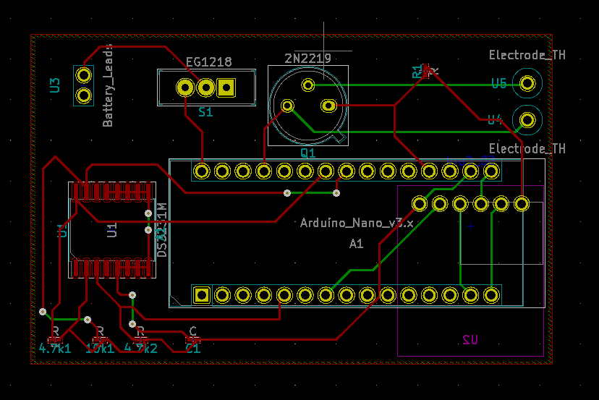

Slide 4
Package
Working on redesigning the nozzle to accommodate a smaller exit tube
Working on making the entire rain gauge 3-D printable so there is no need for PVC pipe

Slide 5
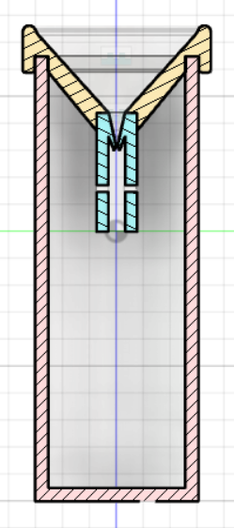
Fusion 360 Model
Working on a fully 3-D printable package
This is the progress so far

Slide 6
Thanks!

